Slide 1




Solution Proposal
MKC SMART System
for Monitoring Facilities at Real Time
Presented By
Presented To
Smart City, Kochi, Kerala, India
www.naicoits.com
Markaz Knowledge City, Landmark World
NH 17 Bypass, Calicut. Kerala. 673014
www.mkconline.com/
c
2021.Naico Information Technology Services

Slide 2
Project Objective
To develop an integrated monitoring system across the MKC campus enabling timely and informed decisions.
The system will enable real time monitoring of various resources within MKC campus and provide actionable insights on the demand, consumption and forecast of resources for optimal utilization, result in increased productivity with enhanced customer experience.

Slide 3
MKC – Campus Facilities
MKC campus is an Integrated Education Township with multiple tenants broadly categorized in to…
Academic Facilities
Residential Facilities
Commercial Facilities
Socio-Cultural Facilities
Healthcare Facilities
Vehicle Parking Facilities
Note: The network connection of the campus utilities can be wired, wi-fi or a combination of both.

Slide 4
Existing MKC Facilities/ Tenants
Tigris Valley | School of Architecture
Fezzin Hotel | School of Business Studies
Excellency Club | Alif Global School
Special Need School | M Tower Apartments
Dormitory/ Admin Block | Sports School
Markaz Law College | Park Masjid
Unani Research Center | Pharmacy College
Unani Medical College | Landmark
Design Bridge International | Hostel near SNS
Library & Research Center | Guest Flow
School of Islamic Studies | Common Areas
Cultural Center | WIRAS

Slide 5
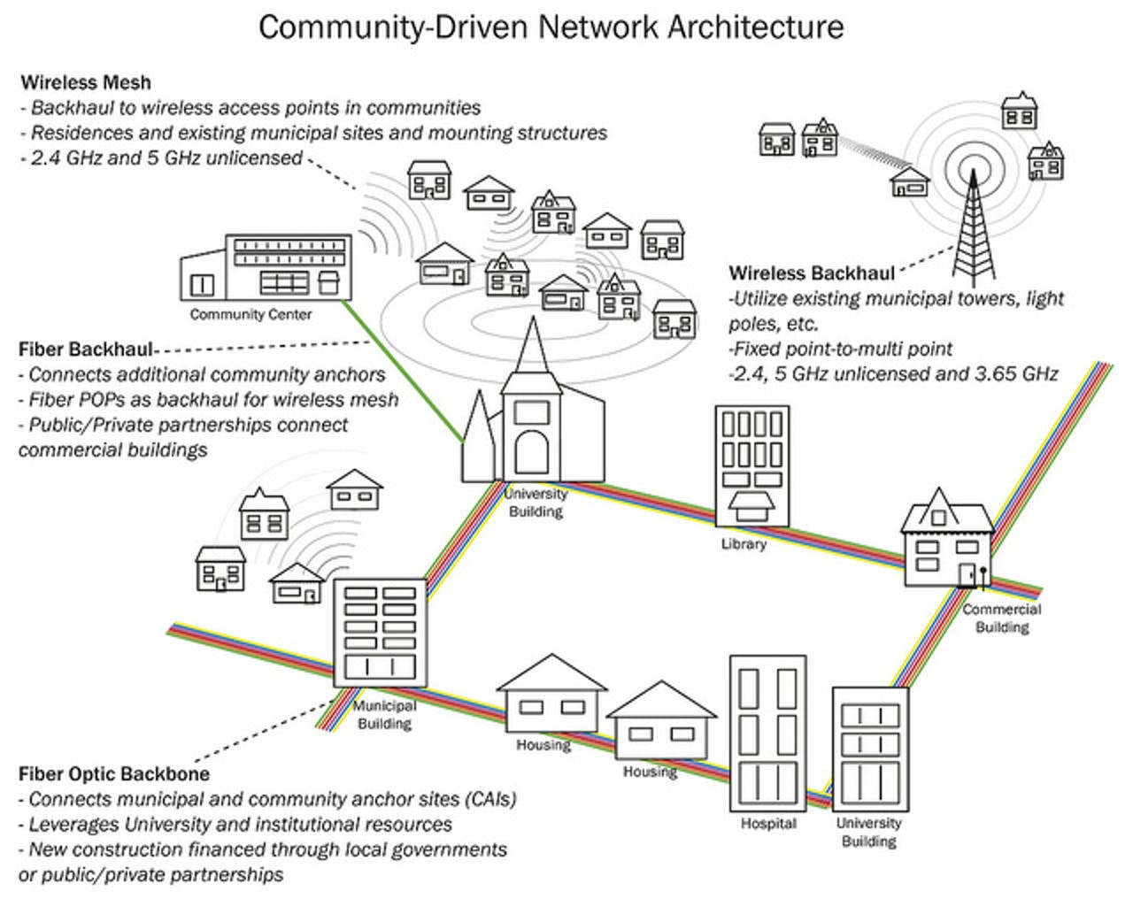
MKC – Campus Infrastructure

Slide 6
Project Scope (1/2)
The project scope includes the following application modules:
Water Resources Management
Power Resources Management
Vehicle Parking Space Management
Environment Monitoring System
Naico will implement a central smart solution encompassing the above management systems. The data from each management system will be obtained from the abovementioned management systems and utilized to gain insights.

Slide 7
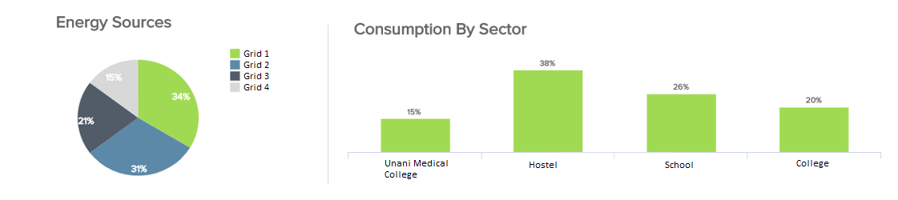
Proposed System Modules – Logical Layout
MKC Facility Monitoring System
Power Resource Management
Vehicle Parking Space Management
Environment Monitoring System
Water Resource Management
MKC Monitoring System Dashboard
Quantity
Source
Quality
Quality Parameters
80+%
60+%
40+%
20+%
10+%
P1 P2 P3

Slide 8
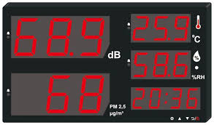

Project Scope (2/2) – MKC Facility Dashboard Requirements
Water Sources Dashboard
Water Treatment Plant
Quality Parameters
Quality
P1 P2 P3
Water level X%
Projected Water availability Y days
Consumption per day Z Liters
Water treatment plant utilisation X%
Consumption per day Z Liters
Power & Energy Dashboard
Parking Space Dashboard
Environmental Monitoring
Total Parking slots 50
Occupancy 30
Vacant slots 20
Power Consumption 700KVA
Load capacity 350 KVA
Source wise 200 KVA
consumption

Slide 9
Water Resource Management – MKC Facility (1/2)
Water Resource Management in MKC facility will be able:
To track the available quantity of the water resources in the campus.
To track the average daily consumption.
To gain insights about the reservation/ storage quantity based on the consumption for a given period.
Sewage Treatment Plant Monitoring System will be included in this system with the following capabilities:
Track the inlet flow
Monitor Qualitative parameters
Track Treated water Consumption
To monitor the qualitative parameters at sewage treatment plant. The quality parameters include:
pH: pH is the measure of how acidic/basic water is. Unit is pH.
Turbidity: Turbidity is the measure of relative clarity of a liquid. Unit is NTU
TDS: Total Dissolved Solids, amount of organic and inorganic materials dissolved in a particular volume of water. Unit is ppm.
COD: The chemical oxygen demand (COD) is the amount of oxygen consumed when the water sample is chemically oxidized.
BOD: The biochemical oxygen demand (BOD) represents the amount of dissolved oxygen (DO) consumed by biological organisms when they decompose organic matter in water.

Slide 10
Water Resource Management – MKC Facility (2/2)
The sensors used for water resources management are:
Water level Sensor: To determine the water level of sources and intermediary tenant water storages.
Digital Flow Meters: To estimate the consumption of water. At the campus and tenants with in the campus.
Quality Parameter Sensors: To track the qualitative parameters for STP and for addition of chemicals.
Note: Data from these sensors will be digitally captured and fed into MKC monitoring system.

Slide 11
Water Resource Management – MKC Campus Dashboard
Note: Dashboard elements for Water Resource Management in MKC facility is shown below. Dashboard for individual tenant will be customized for each tenant with tenant-wise data.
Water Sources
Tenant Storage
Consumption
Waste water
Water Quality
High
Medium
Low
Open Well
Mini Dam
Natural pond
Others
Over head Tank
Slump Tank
Others
Kitchen
Wash Rooms
Toilets
Clinical Rooms
Others
Drainage water
Others
BOD TDS COD Turbidity pH
Water level X%
Projected Water availability Y days
Consumption per day Z Liters
Normal water per day X liters
Recycled water per day Y liters
Water treatment plant utilization X%
Consumption per day Z Liters

Slide 12
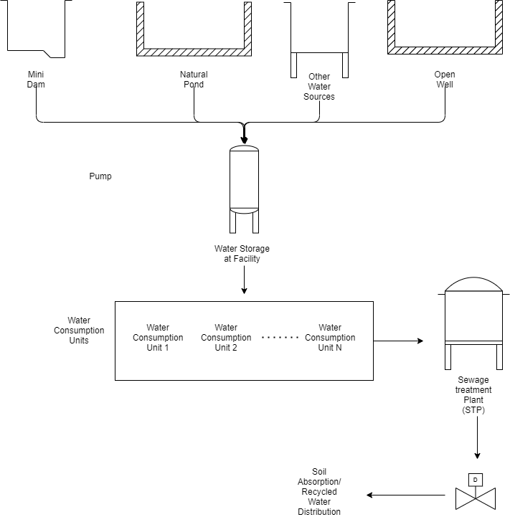
Water Resource Management – Conceptual Layout
Water Level
Flow Rate
Qualitative Parameters
MKC Monitoring System Dashboard
Water Availability
Water Consumption
Water Quality

Slide 13
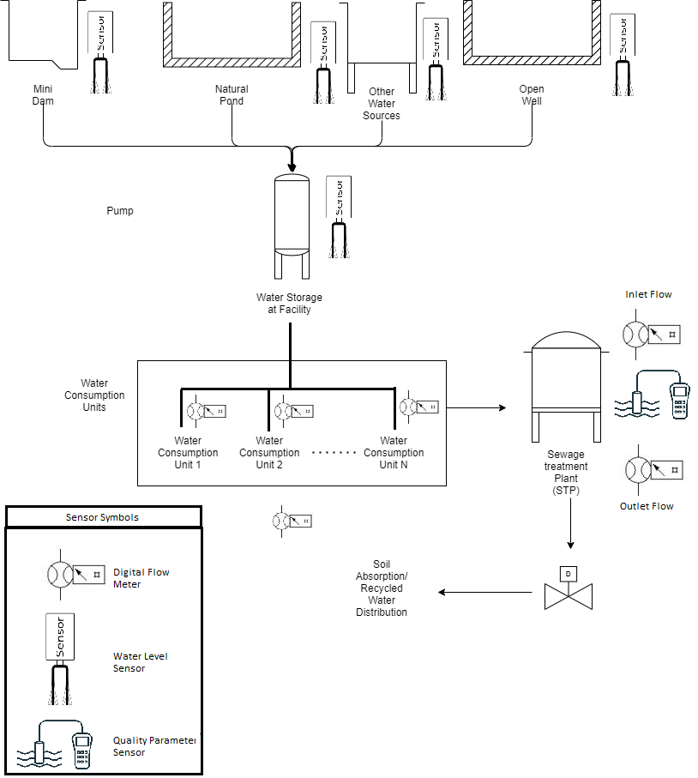
Water Resource Management – Sensor Implementation Layout
MKC Monitoring System Dashboard
Water Availability
Water Consumption
Water Quality

Slide 14
Power Resource Management – MKC Facility
The objective of Power Resource Management is to monitor and manage the power consumption at the MKC campus.
Through Power Resource Management, we will able:
To find out the facility wise consumption and load capacity.
To determine the split-up of power consumption of each facilities by placing smart digital meters for each tenants/ facilities.
To track the load balancing on generator and inverter.
Bill of Materials will be shared to MKC team. Data captured from smart meters will be captured and fed into MKC Monitoring system. The billing calculation for power consumption will be done tenant-wise.

Slide 15
Power Resource Management – Dashboard Elements
Power consumption in the Campus will be captured using smart digital meters installed at the facilities.
Power distribution from multiple sources will be tracked through smart Digital meters.
To compare Load versus source-wise consumption
Naico Dynamic Monitoring Dashboard will provide High level view of Power consumption in the campus with a detailed view of consumption at each tenant and consuming units as required by the tenant to optimize their power consumption.

Slide 16

Power Resource Management – Logical layout
KSEB Grid
Inverter
Transformer
Generator
MKC Monitoring System Dashboard
Solar Panels (Optional)
Tenant
Load capacity - X
Source wise Demand and Consumption
Facility wise Load and Demand
Consumption Timeline Pattern
…
Block 1
Block 2
Block N
- Digital Energy Meter

Slide 17


Vehicle Parking Management System – MKC Facility (1/2)
Vehicle Parking Space Management in Parking Lots is done through cameras. The count of incoming and outgoing vehicles are calculated by number of camera clicks (snap image count) for calculating the space occupancy. The difference in the count will denote the space occupancy.
MKC Campus
MKC Monitoring System Dashboard
Gate-Out Camera
Gate-In Camera
Campus Parking Data
Tenants/ Facilities
Vehicle Space Availability
Space Occupancy
Camera In
Combined Parking Data
TenantParking Data
Camera Out

Slide 18
Vehicle Parking Management System – MKC Facility (2/2)
Cameras will be installed in campus Gate-In and Gate-Out. A snapshot will be taken when the vehicle comes in or goes out of the gate. The difference in count of snapshots taken from Gate-In and Gate-out cameras will be used to count the number of vehicles present inside the campus.
The ‘Camera In’ & ‘Camera Out’ camera equipment installed respectively at entry and exit points in the parking lots of each tenants. The count of unique snaps will be used as captured data to estimate the space occupancy of the parking lot with respect to each tenant.
The data captured will be fed into MKC monitoring system to gain insights.

Slide 19
Environment Monitoring System
There will be built-in modules installed in the campus to determine the air quality and meteorology data. The Meteorology and atmospheric data will be captured through sensors which will be installed inside the MKC campus. The sensor data captured will be fed into MKC monitoring system to gain insights.
Ambient air quality
Air Quality Index (AQI)
Wind Speed & direction
Temperature
Humidity
Rainfall
MKC Monitoring System Dashboard
Meteorology
Qualitative Measures
Weather Report

Slide 20
Pilot Implementation of MKC Monitoring System – WIRAS Facility
WIRAS (World Institute of Research & Advanced Studies) is a pilot project for smart building project with MKC. WIRAS, a building facility houses over 300 students helping them with their education and accommodation. In addition, WIRAS also accommodates over 10 staffs in the facility.
The objective of the pilot project will be to monitor and control the consumption of water and power supply within WIRAS campus along with managing the operations of sewage treatment plant.

Slide 21
WIRAS Facility – Existing Water Resources
All water supply needs for WIRAS facility is addressed by an Overhead tank (OH).
There are 2 primary water sources which supplies water to Overhead Tank, they are the Mini dam (Artificial Dam) and Open well situated at different locations inside MKC campus.
From the overhead tank, water is supplied to Kitchen, washroom and toilet flush. The used water from Kitchen, domestic taps and bathrooms/ washrooms flows directly to Sewage Treatment Plant (STP). The used water from the toilets flows to the septic tank. The overflow from the septic tank flows directly to Sewage treatment plant.
Available details of water resources in WIRAS are:
Over Head tank (80000 KL): Available for consumption (40000 KL). Balance water is reserved for emergency and Fire - and safety compliances.
Source of water Supply ( Connected Sources)
Open Well (6m diameter)
Mini Dam (2 Cr Liter)
Water Consumption Facilities
Kitchen
Washrooms
Toilet Flushing
Sewage Treatment
Sewage Treatment Plant (50 KLD)
Drainage (Kitchen + Washroom)
Septic Tank (80 KL)

Slide 22
WIRAS Facility – Existing Power Resources
One HT line (Individual metering) from KSEB main power lines is distributed to 5 buildings as individual LT lines (normal metering/ analog metering). The distribution is through 400 KV transformer. One of 5 lines is connected to WIRAS facility. In each 5 lines, analog metering is provided in each feeder for getting the meter readings of power consumptions.
WIRAS has a routed and metered power supply from KSEB with a load capacity of 133KV supported by a DC generator of 62.5 KVA. The connected load is estimated to be 150 KV including AC units. The demand is currently limited to 20 KV but when the student capacity increases, load limit raises to 30-40 KV range. Currently, the AC unit provisioning is limited in WIRAS facility.
WIRAS mainly consists of consumption units and power backup units as shown in the tables below:
Power Consumption Blocks
Hostel
Classrooms
Admin Office (Chairman, MD)
Power Backup Units
Inverter (5KVA)
AMF Generator (62.5 KVA)
Solar Panels (Optional)

Slide 23
Pilot Implementation of MKC Monitoring System – WIRAS Facility
MKC Monitoring System Dashboard for WIRAS
Power Consumption Data - WIRAS
Power Consumption Meter Readings
Load Factor data
Water Resource & STP Management
Water Consumption Data - WIRAS
Water Level
Flow Rate
Qualitative Parameters (STP)
Power Resource Management

Slide 24
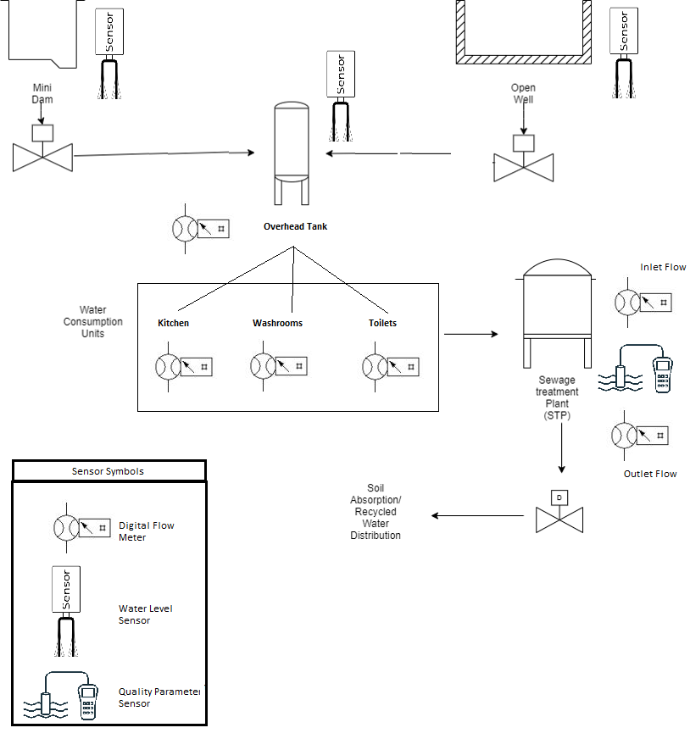
Water Resource Management of WIRAS – Logical Layout with Sensors
Water Level
Flow Rate
Qualitative Parameters
MKC Monitoring System Dashboard
Water Availability
Water Consumption
Quality Level Data for addition of chemicals
Note:
Identified water consumption units are Kitchen, washroom and Toilets.
Dashboard will also monitor the addition of chemicals in Sewage treatment plant.

Slide 25
Power Resource Management of WIRAS – Logical Layout
Load capacity – 133 KV
KSEB Grid
Inverter
Transformer
Generator
MKC Monitoring System Dashboard
WIRAS
Load capacity – 150 KV
Source wise Demand and Consumption
Facility wise Load and Demand
Consumption Timeline Pattern
Classrooms
Hostel
Admin
Office
Note: Identified power consumption units/ blocks are classroom, Admin offices and Hostel.
- Digital Energy Meter

Slide 26
Sensor Details & Specifications – Water Resource Management (1/2)
Sl No: | Water Sensor | Specifications | Data Communication
1 | Digital Flow Meter Sensor | Mini. Working Voltage: DC 4.5V Max. Working Current: 15mA (DC 5V) Working Voltage: DC 5V~24V Flow Rate Range: 1~30L/min Flow Pulse: F(Hz)=(5.0*Q)&plusmn;3% Q=L/Min Load Capacity: &le;10mA (DC 5V), Operating Temperature: 80 celsius Liquid Temperature: 120 celsius Operating Humidity: 35%～90%RH Water Pressure: 1.75MPa Storage Temperature: -25～+ 80℃ Storage Humidity: 25%～95%RH Weight G.W 22.5g Battery Excluded Price: ~ ₹800 approximately | Communication will be through wired connection. RS485 protocol will be used.

Slide 27
Sensor Details & Specifications – Water Resource Management (2/2)
Sl No: | Water Sensor | Specifications | Data Communication
2 | Water Level Sensor | Product Name: Industrial Liquid Level Sensor MODBUS RS485 Aviation Connector Strong anti-interference and long-term stability Anti-corrosion material, excellent anti-corrosion performance, and durable Anti-blocking design, easy to clean Modbus-RTU RS485 protocol, it can be used with a display device, PLC, inverter, recorder, and other instruments The shell is made of stainless steel and durable, and with waterproof cable, safe to use Price: ~ ₹10,000 approximately | RS485 Communication

Slide 28
Sensor Details & Specifications – Power Resource Management
Sl No: | Device Name | Data Communication
1 | Smart Energy Meter | Single Techno RS 232 Port Energy Meter 1 Phase, 240 Phase: Single Brand: TECHNO Model Name/Number: TMCB012 RS 232 Voltage: 240V Usage/Application: ALL Version Of Communication: RS 232 PORT Type: Digital Price: ~₹ 1,600 approximately

Slide 29
Sensor Details & Specifications – Sewage Treatment Plant (1/3)
Sl No: | STP Sensor | Specifications | Data Communication
1 | pH Sensor | Wide-range power supply: 3.6V ~ 30V Robustness: suitable to be immersed in soil or water for a long time Maintenance-Free: advanced junction design, no clogging Durable: anti-corrosion, automatic temperature compensation User-friendly: Easy to install and integrate Price range: ~ ₹10,000 approximately | Universal protocol: MODBUS RS-485 or 4~20mA current
2 | Turbidity Sensor | Low power consumption Small size: 2.0cm x 4.0cm Grove module Only 3 pins needed, save I/O resources Easy to use: Grove connector, plug and play Output mode optional, support analog output and digital output Operating Voltage: 3.3V/5V DC Output Interface: Analog/Digital Connector: 1 Grove, 1 power interface LEDs: 1 power LED, 1 signal LED Switch: 1 A-D toggle switch Dimensions: 20x40 mm Price Range: ~ ₹2,000 approximately | Serial Communication

Slide 30
Sensor Details & Specifications – Sewage Treatment Plant (2/3)
Sl No: | STP Sensor | Specifications | Data Communication
1 | TDS Sensor | High performance: high accuracy, fast response, good repeatability Wide-range power supply: 3.9V ~ 30V Robustness: suitable to be immersed in water for a long time Durable: anti-corrosion, automatic temperature compensation User-friendly: Easy to install and integrate Output Interface: Analog Voltage 0-2V (Output resistance ~0ohm), RS485 Modbus-RTU Power Supply: 3.9-30V/DC Power Consumption (Idle): 40mA@24V DC Power Consumption (Max): 80mA@24V DC Start-up Time: < 2 seconds Temperature Measurement: Range: -40~80°C Price: ~ ₹10,000 approximately | Universal protocol: MODBUS RS485, 0-2V

Slide 31
Sensor Details & Specifications – Sewage Treatment Plant (3/3)
Sl No: | STP Sensor | Specifications | Data Communication
1 | COD & BOD Sensor | Measurement Principle: Attenuation, Transmission Range: 0-2000 mg/L Measurement Technology: Light Source: 2 LED(254nm, 530nm) Detector: Photo diode + Filter Turbidity Compensation: at 530 nm Optical path : 1mm,2mm,5mm,10mm,50mm T100 Response Time: 4s System Compatibility: Modbus RTU Power Consumption: <- 1W Sample Temperature: 2 to 40 Degree C I ~+36 Degree F to +104 Degree F Price Range: ~ ₹5,00,000 approximately | Serial Communication

Slide 32
Sensor Details & Specifications – Environment Monitoring & Vehicle Parking – 1/3
Sl No: | Other Sensors | Specifications | Data Communication
1 | Camera (Vehicle Parking) | IP Cameras Starting Price: ~ ₹4,000 onwards/ unit | Direct Communication through IP address
2 | Air Quality Index Sensor (Environment Monitoring) | Adafruit SGP40 Air Quality Sensor Breakout – VOC Index – STEMMA QT/Qwiic Circuit: SGP40 Supply voltage: 3 V to 5 V Communication interface: I2C I2C communication interface address: 0x59 VOC Measuring range: 0 ppm to 1000 ppm VOC index value Measuring range: 0 to 500 Connectors: STEMMA QT / Qwiic Price: ~₹2200.00/ piece approximately | I2C Communication

Slide 33
Sensor Details & Specifications – Environment Monitoring & Vehicle Parking – 2/3
Sl No: | Other Sensors | Specifications | Data Communication
3 | Wind Speed Sensor (Environment Monitoring) | Wind Speed Sensor Current Type(4 to 20mA) Anemometer Kit (Waterproof & Industrial) The mode of its output signal:4 to 20mA supply voltage: DC 12-24V. Power consumption: MAX≤0.3W. Start wind speed：0.4-0.8m/s. Effective measurement range:0-30m/s Transmission distance (m):< 1000 m Price: ~ ₹5,000 approximately | Serial Communication
4 | Temperature and Humidity Sensor | Temperature-Humidity Sensor-AF5485 (Encased RS485 ) high performance industrial network-based temperature and humidity transmitter. Price: ~ ₹4,000 approximately | RS 485 Communication

Slide 34
Sensor Details & Specifications – Environment Monitoring & Vehicle Parking – 3/3
Sl No: | Other Sensors | Specifications | Data Communication
5 | Rainfall Sensor | Industrial-Grade Optical Rain Gauge RG-9 Rain Sensor Detects the size of raindrops and provides information on rain intensity to the users. It features easy-installation and maintenance-free, suitable for applications in weather and climate studies, hydrological network monitoring, agriculture, and other scenarios that need monitoring rainfall. Price: ~ ₹4,000 approximately | Serial Communication

Slide 35
Technical Assumptions
Sensors will be communicating with RS-485 protocol through a wired connection (serial communication). Connection range is approximately 3000 ft.
In case of installing sensors in Sewage treatment Plant, sensors will be integrated into single unit as part of cost-effective approach.
VSS Sensor and Coliforms Sensor for STP are not included.

Slide 36


Naico Information Technology Services (P) Ltd Office No. O405B, 4th Floor, SCK 01,
SmartCity Kochi, Kerala, India
Pin: 682042
+91 484 4060130 getinfo@naicoits.com www.naicoits.com
Thank You

